Slide 1


School of Engineering Technology and Applied Science
Performance Provisioning in MapReduce
Reza Dibaj

Slide 2
Contents:
History of Databases
NoSQL
Hadoop
Structured vs Unstructured
Relational Tables vs Key-Value
MapReduce
Introduction
Architecture
Basic Concepts
DBMS vs MapReduce
Advantages and Pitfalls

Slide 3
History
1980s
Billing
SQL, a dominant database environment
SQL
Data Persistency
Integration and Reporting for many Organizations
Impedance mismatch
Inventory

Slide 4
History
1990s
Rise of Object Databases
In memory structure → Save data directly from memory to disk
Still we have Relational Dominance

Slide 5
History
2000s
Amazon
Google
High Traffic
1st Solution: Scale up the hardware
Buy Bigger Boxes (BBB)
2nd Solution: Scale out the hardware
Buy Lots of Little Boxes
Problem: SQL was designed to work on a large box, and not on a large amount of small boxes.

Slide 6
History
2000s
NoSQL Movement
Some organizations started to work on something rather than traditional
SQL environments
Google → BigTable (Column Family)
Amazon → Dynamo (Key-Value)

Slide 7
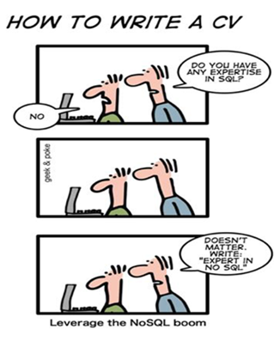
NoSQL
Whenever we talk about Big Data we talk about unstructured data.
Some NoSQL Characteristics
Non-relational (Unstructured)
Cluster-friendly
Open-source

Slide 8
NoSQL
NoSQL Data Models
Key-value
Document data model
Column-family
Graph
Aggregate-Oriented, Not ACID
Graphs are ACID (Atomic, Consistent, Isolated, Durable)
All NoSQL Data Models are Schema-less
Aggregate-Oriented DBs are naturally fit-in storing data on large clusters.
Graphs are good for handling relationship between things. Even relational Databases work with a high degree of complexity with relationships, while graphs are very good at this feature. There is a kind of query language specifically designed for that.

Slide 9
NoSQL
NoSQL
Easier development
Large-scale data (Big Data)
Is NoSQL the future of Databases?
We will have different models of Databases, and we should chose the appropriate one for our specific problem.

Slide 10
Hadoop Objectives
Hadoop
Running applications on Big Data
Supports

Slide 11
Open-Source Environment
Hadoop
Open-Source set of tools distributed under Apache License
is

Slide 12
Big Data Challenge Points
Velocity
Volume
Variety

Slide 13
Traditional Approach
Enterprise Approach
Powerful Computer
Big Data
Processed by

Slide 14
Traditional Approach
Enterprise Approach
Big Data
Powerful Computer
Processing Limit

Slide 15
Breaking the Data
Hadoop’s Approach
Big Data
is broken into pieces

Slide 16
Move Computation to the Data
Hadoop’s Approach
Computation
Computation
Big Data
Combined Result
Computation
Computation

Slide 17
Hadoop’s Architecture
MapReduce
File System
(HDFS)
Projects

Slide 18
MapReduce and HDFS
Task Tracker
Job Tracker
MapReduce
Data Node
Name Node
HDFS
Any application contacts the Master Node.
Then the task will go into the queue.

Slide 19
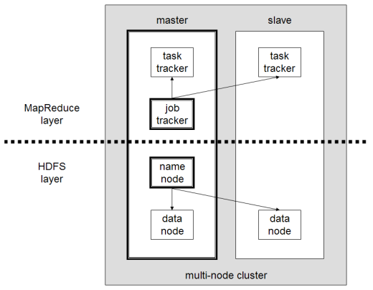
Hadoop’s Architecture

Slide 20
Distributed Model
Low Cost Computers
Works on Linux Based Machines
Linux
Linux
Linux
Linux

Slide 21
Task Trackers and Data Nodes
Slaves
Task Tracker
Task Tracker
Task Tracker
Task Tracker
Data Node
Data Node
Data Node
Data Node

Slide 22
Master
Task Tracker
Job Tracker
Master
Data Node
Name Node
Slaves
Task Tracker
Task Tracker
Task Tracker
Task Tracker
Data Node
Data Node
Data Node
Data Node

Slide 23
MapReduce and HDFS
Break higher bigger task to smaller pieces and to send each smaller piece of computation to the task trackers. It also can combine the results and send it back to the application.
Job Tracker
It is responsible to keep the index that which data is resides on which data node. When application contacts a Name Node, it tells the application that in order to get your particular data; you should go to which computer.
Name Node

Slide 24
An Introduction to MapReduce
MapReduce
Simple
Scalable
Fault-tolerant
limitations on its performance and efficiency

Slide 25
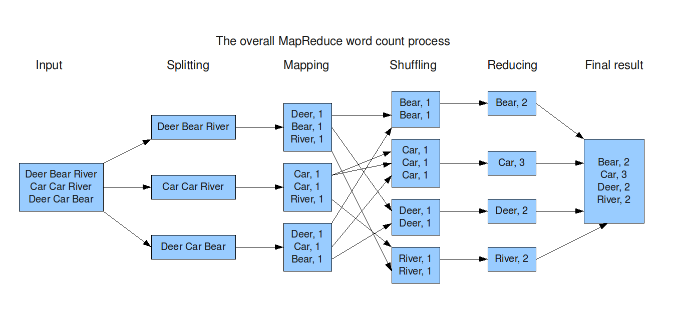
MapReduce Architecture

Slide 26
Fault Tolerance for Data
Task Tracker
Job Tracker
Data Node
Name Node
Task Tracker
Task Tracker
Task Tracker
Task Tracker
Data Node
Data Node
Data Node
Data Node

Slide 27
Fault Tolerance for Processing
Task Tracker
Job Tracker
Data Node
Name Node
Task Tracker
Task Tracker
Task Tracker
Task Tracker
Data Node
Data Node
Data Node
Data Node

Slide 28
Scalable
Task Tracker
Job Tracker
Scalable
Data Node
Name Node
1000s
Task Tracker
Task Tracker
Task Tracker
Task Tracker
Data Node
Data Node
Data Node
Data Node

Slide 29

Easy Programming
Where the program is located
Programmers
How to manage the failures
Do not have to worry about
How to break computations into smaller pieces
How to program for scaling

Slide 30
Easy Programming
Programmers
Writing Scale-free Programs
Could focus on

Slide 31
Scalability Cost
Linear
Processing Speed
Number of Computers

Slide 32
Hadoop’s Projects
MapReduce
File System
(HDFS)
Projects

Slide 33
Hadoop’s Projects
Hive
HBase
Mahout
Projects
Pig
Oozie
Flume
Scoop

Slide 34
Little about Hadoop’s History
2004-2005
Hadoop was created in 2005 by Doug Cutting and Michael Cafarella who both worked for Yahoo!
2006
In 2006 the project was donated to Apache.

Slide 35
Hadoop’s Users
Administrators
Installation
monitoring/managing the system
tuning the system
Users
Design Applications
Import/Export Data
Work with tools

Slide 36
Hadoop’s Usage Areas
Social Media
Retail
Financial Services
Searching Tools
Governments
Intelligence

Slide 37
Hadoop’s User Companies
Yahoo
Facebook
Amazon
eBay
American Airline
The New York Times
Federal Reserve Board
Chevron
IBM

Slide 38
Outlook of Hadoop
By 2015 more than 50% of Enterprise Data was processed by Hadoop

Slide 39
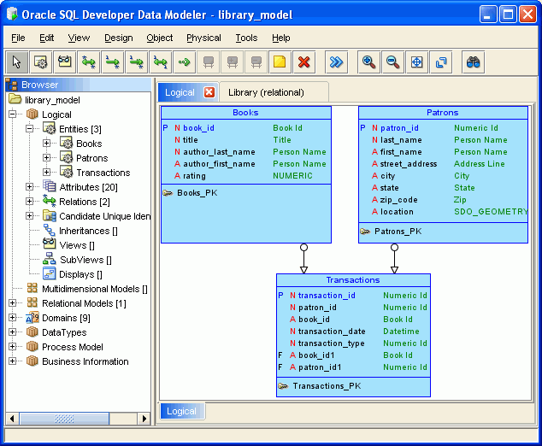
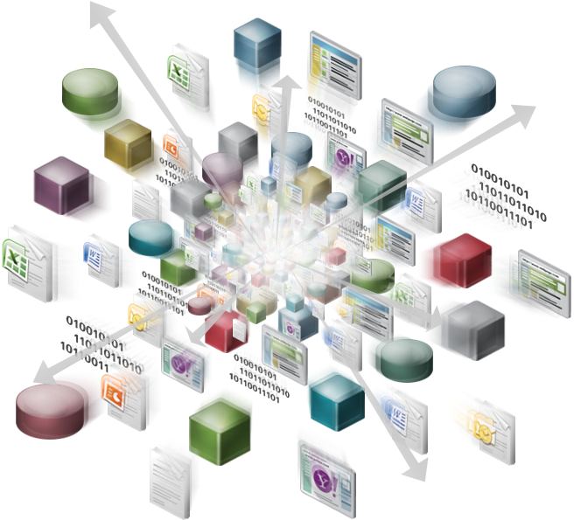
Structured vs Unstructured
SQL
Hadoop
is by design targeted at structured data.
many of its initial applications deal with unstructured data such as text.

Slide 40
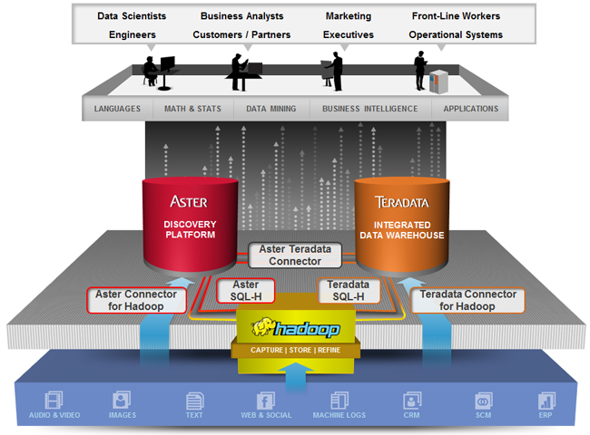
Structured vs Unstructured
SQL and Hadoop can be complementary, as SQL is a query language which can be implemented on top of Hadoop as the execution engine.

Slide 41
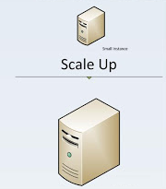
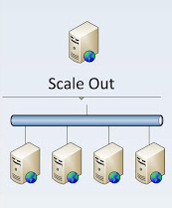
Structured vs Unstructured
SQL design is more friendly to scaling up.
Hadoop is designed to be a scale-out architecture operating on a cluster of commodity PC machines.

Slide 42
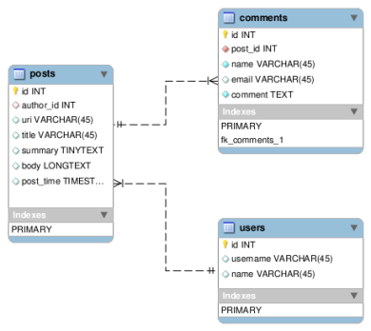
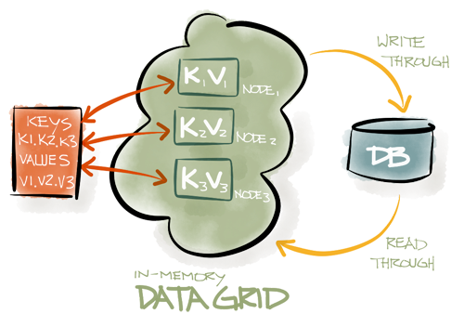
Relational Tables vs Key-Value
In SQL data resides in tables having relational structure defined by a schema.
Hadoop uses key/value pairs as its basic data unit, which is flexible enough to work with the less-structured data types.

Slide 43
Declarative Query vs Functional Programming
Under SQL you have query statements.
Under Hadoop you have scripts and codes. MapReduce allows you to process data in a more general fashion than SQL queries.
SELECT Book.title AS Title, COUNT(*) AS Authors
FROM Book
JOIN Book_author
ON Book.isbn = Book_author.isbn GROUP BY Book.title;
function map(String name, String document):
// name: document name
// document: document contents
for each word w in document:
emit (w, 1)
function reduce(String word, Iterator partialCounts):
// word: a word
// partialCounts: a list of aggregated partial counts
sum = 0
for each pc in partialCounts:
sum += ParseInt(pc)
emit (word, sum)

Slide 44
DBMS vs MapReduce
DBMS
Generates a query plan tree for execution
MapReduce
A plan for executions in MapReduce is determined entirely at runtime

Slide 45
Pros and Cons
Debate
DBMSs have adopted “one size fits all” strategy and are not suited for solving extremely large scale data processing tasks.
MapReduce is referred to as a new way of processing big data in data-center computing.
Slow
Hadoop is 2∼50 times slower than parallel DBMS except in the case of data loading.
Poor Efficiency
Hadoop system is scalable, but achieves very low efficiency per node, less than 5MB/s processing rates, repeating a mistake that previous studies on high performance systems often made by “focusing on scalability but missing efficiency”
Loosing efficiency for the fault tolerance: MapReduce increases the fault tolerance of long-time analysis by frequent checkpoints of completed tasks and data replication.

Slide 46
MapReduce Advantages and Pitfalls
Simple and easy to use
Flexible
Independent of the storage
Fault-tolerance
High scalability
No high-level language
No schema and no index
A single fixed dataflow
Low efficiency
Very young

Slide 47
References
[1]Lee, K. H., Lee, Y. J., Choi, H., Chung, Y. D., & Moon, B. (2012). Parallel data processing with MapReduce: a survey. AcM sIGMoD Record, 40(4), 11-20. doi: 10.1145/2094114.2094118
[2]Pavlo, A., Paulson, E., Rasin, A., Abadi, D. J., DeWitt, D. J., Madden, S., & Stonebraker, M. (2009, June). A comparison of approaches to large-scale data analysis. In Proceedings of the 2009 ACM SIGMOD International Conference on Management of data (pp. 165-178). ACM. (3) The performance of MapReduce: an in-depth study. doi: 10.1145/1559845.1559865
[3]Jiang, D., Ooi, B. C., Shi, L., & Wu, S. (2010). The performance of MapReduce: an in-depth study. Proceedings of the VLDB Endowment, 3(1-2), 472-483. doi: 10.14778/1920841.1920903
[4]Eltabakh, M. Y., Özcan, F., Sismanis, Y., Haas, P. J., Pirahesh, H., & Vondrak, J. (2013, March). Eagle-eyed elephant: split-oriented indexing in hadoop. InProceedings of the 16th International Conference on Extending Database Technology (pp. 89-100). ACM. doi: 10.1145/2452376.2452388
[5]Chen, G., Vo, H. T., Wu, S., Ooi, B. C., & Özsu, M. T. (2011). A Framework for Supporting DBMS-like Indexes in the Cloud. Proceedings of the VLDB Endowment, 4(11), 702-713. doi: 10.14778/2556549.2556550

Slide 48

Thank you

